Slide 1
Sistem Programlamaya Giriş
BIL220

Slide 2
What will BIL220 teach you?
You will learn how to harness the power of microprocessors
You will learn how the “brains”, “memory” and “sensors” of a computer work together to perform powerful tasks
You will learn how to “speak” (write) the language of hardware to get them to perform complex tasks

Slide 3
Lecture Outline
How to navigate for success in BIL220
Course Syllabus
Highlights in the history of computers
Number systems review

Slide 4
The course at a glance
Computer Engineering II
The bridge between your logic design classes and your high-level programming classes
Assembly language programming
Organization of a real microprocessor
Interface to external hardware devices
A lot of work

Slide 5
Objectives
To become the best assembly language programmers!
Learn and manage the resources of a microprocessor
Learn the principles of machine-level programming
Organize and write large programs
Program the devices connected to a computer
Develop your engineering skills
  Design flows
  Time management
  Work as hard as required to make your deadlines

Slide 6
Machine problems
MP0 will introduce you to NASM and the tools you’ll use for the MP’s and final project
MP1 - simple programming constructs like loops and subroutines
MP2 – recursion, algorithms, math
MP3 – interrupts, text-mode graphics, serial communication
MP4 – advanced graphics, protected mode

Slide 7
History of Computers
1945 John Von Neumann proposes the stored program architecture
1948 Bardeen, Brattain and Shockley invent the transistor
1958 Jack Kilby (UI alumni) introduces the IC (integrated circuit) and opens the road for computing on chips
1960 Computers start to use transistors
1965 Gordon Moore claims that the capacity of chips doubles every 18 months with associated improvements in performance

Slide 8
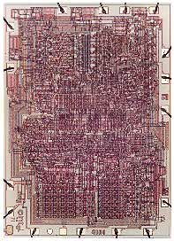
History of Computers
1971 Intel introduces its first microprocessor, the 4004, which contained 2250 transistors
Courtesy of Intel’s microprocessor hall of fame

Slide 9
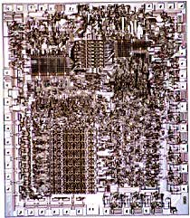
History of Computers
1974 Intel introduces the 8080, which later became the heart of the first personal computer, a $379 kit named Altair
Courtesy of Intel’s microprocessor hall of fame

Slide 10
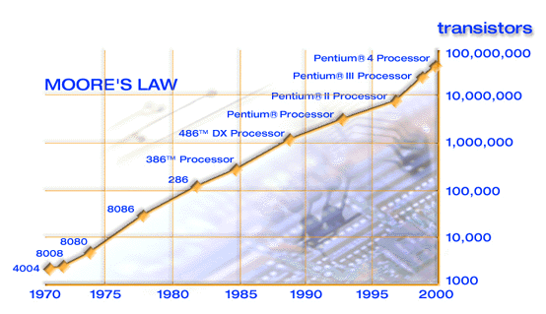
History of Computers
In 1965 Gordon Moore predicted that the number of transistors in a microprocessor will double every 18 months and this trend will hold till 1975…

Slide 11
History of Computers
Moore’s law is good for the last 26 years!
1971: 4004 | 2,250 transistors
1972: 8008 | 2,500 transistors
1974: 8080 | 5,000 transistors
1978: 8086 | 29,000 transistors
1982: 80286 | 120,000 transistors
1985: 80386 | 275,000 transistors
1989: 80486 DX | 1,180,000 transistors
1993: Pentium | 3,100,000 transistors
1997: Pentium II | 7,500,000 transistors
1999: Pentium III | 24,000,000 transistors
2000: Pentium IV | 42,000,000 transistors

Slide 12
History of Computers
1974 William H. Gates and Paul Allen write a BASIC interpreter
1981 IBM introduces the fist PC, with a 16-bit 8088 running at 4.77 MHz, using cassettes, optional floppy and a BAD operating system called DOS
1983 First “affordable” PCs
1984 Introduction of the Windows interface (work pioneered at Xerox labs)
1985 First 32-bit microprocessor (80386)

Slide 13
History of Computers
1989 80486, math co-processor included
1992 Pentium (64-bit memory bus)
1996 Pentium Pro (RISC core for the x86 ISA)
1997 Pentium II, MMX
1999 Pentium III, IA-64 (explicitly parallel processor)

Slide 14
Current trends
Parallelism in microprocessors
  Multithreaded execution
  SIMD parallelism
  Explicit instruction-level parallelism
Low-power portable computing
  Reducing the energy consumed by microprocessors
  Computing in laptops, handheld devices, watches (check out IBM’s Linux watch!), sensors
Internetworking and ubiquity
  Services available over wired or wireless networks

Slide 15
Number Systems Review
You should be familiar with Boolean algebra, basic arithmetic operations on binary numbers and the following material from your earlier logic classes
The numbers we’re using are in base10 representation
d_{n} ∈ (0…9)
d_{n}d_{n-1…}d₀ = d_{n}10^{n}+ d_{n-1}10^{n-1} +…+ d_{o}10⁰
Example:
9823₁₀ = 9*10³+8*10²+2*10¹+3*10⁰

Slide 16
Number Systems Review
Computers use binary numbers d_{n} ∈ (0,1)
d_{n}d_{n-1…}d₀ = d_{n}2^{n}+ d_{n-1}2^{n-1} +…+ d_{o}2⁰
Example:
110101₂ = 1*2⁵+1*2⁴+0*2³+1*2² +0*2¹ +1*2⁰ = 32+16+0+4+0+1=53

Slide 17
Number Systems Review
We use hexadecimal (hex) representation of binary numbers for convenience
  Easy conversion, each hex digit is 4 bits
  More compact representation
Example:
9E7₁₆= 1001 1110 0111₂ = 9*16²+14*16¹+ 7*16⁰ = 2535

Slide 18
Base Conversion
Division/remainder method
Assume we convert n to base b
We divide n with the largest power of b which is less than n, to obtain the first digit
If r is the remainder we repeat with the largest power of b which is less than r, to obtain the second digit and so on…
Class Example : Convert 193₁₀ to binary

Slide 19
Number Representation
The size of a number in digits defines the range of numbers we can represent
Popular sizes
  Bits: a binary digit
  Bytes: 8 binary digits
  Words: 16 binary digits (for the purposes of this class)
  Double words: 32 binary digits (for the purposes of this class)

Slide 20
Number Representation
The numbers we can represent depend on the size of the representation
With 8 bits (a byte) we can represent numbers from 0 through 255₁₀ (1111 1111₂ or FF₁₆)
With 16 bits (a word) we can represent numbers from 0 through 65535 (FFFF₁₆)
How do we represent negative numbers ?

Slide 21
Number Representation
Easy solution: use the first bit as the sign bit
0 is positive (+), 1 is negative (-)
Examples:
83 = 01010011
-71 =10100111
Is this a good idea ?
  Two representations of 0 (+0,-0)
  Difficult to process positive and negative numbers simultaneously
  Can you think why ?

Slide 22
Number Representation
Use two’s complement arithmetic
First bit still represents the sign
If –n is the number we want to represent
  Invert the bits of +n, then add 1
  Or, scan n from right to left, copy leading 0s and the first 1, invert the rest of the bits
Example –109
109₁₀=01101101₂
-109= 10010011

Slide 23
Why two’s complement ?
Easy to handle positive and negative numbers!
  Check how easy it is to compute A-B
  A+(-B)
  Example:
  83 = 01010011
-71 =10111001
(1) 00001100

Slide 24
Things to remember
With n bits you can represent the number from –2^{n} to +2^{n-1}
-1 is a string of 1s
–2^{n} is 1 and the rest 0s
+2^{n} is invalid, unless you move to a larger register (i.e. a representation of a larger size)

Slide 25
Sign extension and contraction
Whenever you move from a m-bit to a n-bit representation, n > m, just copy the sign bit to all the additional bits in the extended representation
Examples:
77₁₀ = 0100 1101₂ = 0000 0000 0100 1101 (16-bit)
-71 =1011 1001₂ = 1111 1111 1011 1001 (16-bit)
Contraction is the opposite to extension
You cannot sign contract a n-bit number to a m-bit number unless the high order (n-m) bits are all 0’s or 1’s

Slide 26
Real numbers in binary
Integer conversion goes on for the fractional parts
d_{n}d_{n-1…}d₀ d₋₁ d_{-2…} = d_{n}10^{n}+ d_{n-1}10^{n-1} +…+ d_{o}10⁰ + d₋₁10⁻¹+ d₋₂10⁻²…
Example 40.63 = 4*10² + 0*10¹ ⁺ 0*10⁰ + 6*10⁻¹ + 3*10⁻²
Same thing for binary numbers
Example: Convert 10111.011 to decimal
1*2⁴ + 0*2³ + 1*2² + 1*2¹ + 1*2⁰ + 0*2-¹ + 1*2-² + 1*2-³ = 23.375
For signed unsigned you just add the sign bit in the front of the number

Slide 27
Hints for MP0
Edit, assemble, debug and execute a simple program
We provide you a template file
You will have to edit the template file
  Your instructor has been using vi and he’s happy with it for the last 11 years or so
  We recommend you gVim Easy (start menu option)
You will assemble and link your program using the make utility
  During your career as a programmer learning how to read and write make files is an invaluable skill
You will execute your program from the command line
You will learn how to use the Turbo Debugger (TD) to track down your logical errors

